Slide 1
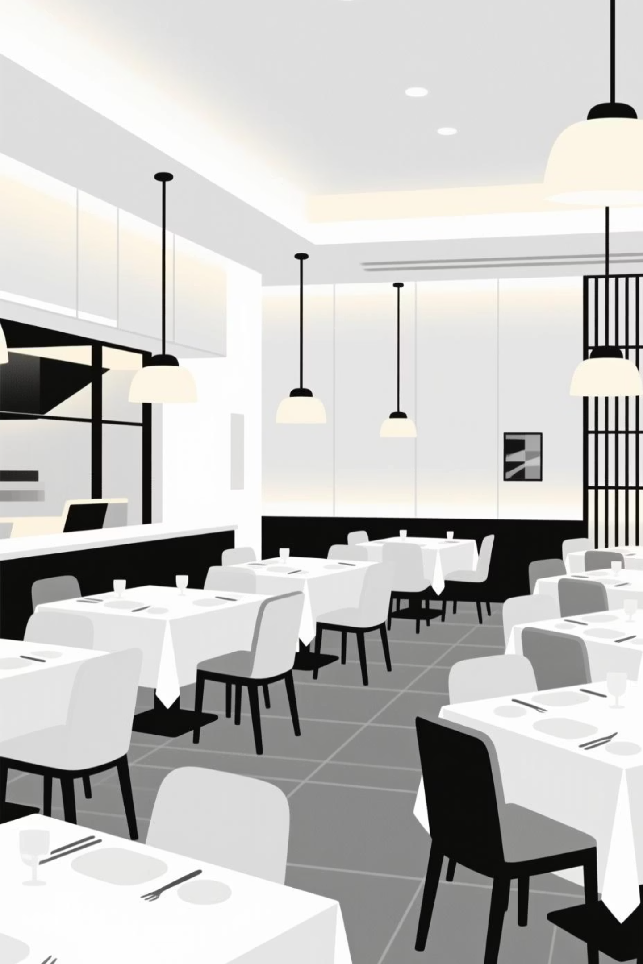
Restaurant Reservation & Table Booking System
Presented by:
Bhavesh Bagul 202201040104
Yash Sarode 202201040115
Guruprasad Dahiphale 202201040117
Abhijit Jadhav 202201040122
Guided by: Prof. Kavitha Ma’am
Institution: Department of Computer Science & Engineering

Slide 2

Agenda
01
02
03
Overview & Problem Identification
Project Objectives
System Design
Defining aims, justification, and comprehensive requirements
Architecture, UML diagrams, and interface design approaches
Understanding the current challenges in restaurant booking systems
04
05
Implementation Details
Testing & Future Vision
Business logic, database structure, and security frameworks
Usability optimization, testing results, and expansion opportunities

Slide 3

Problem Statement
Defining the Core Challenge
The restaurant industry continues to rely heavily on manual or phone-based reservation systems, creating significant operational inefficiencies and customer frustration.
Key Issues Identified:
High error rates from manual entry and transcription mistakes
Double-booking incidents that damage customer trust
No real-time visibility into table availability
Poor coordination between front-of-house staff
Limited customer convenience and booking flexibility
These challenges result in lost revenue, decreased customer satisfaction, and inefficient resource allocation during peak hours.

Slide 4
Project Aim
Primary Objective
Develop a comprehensive web-based reservation system that automates the entire booking lifecycle—from initial table search to confirmation and cancellation—while providing restaurant managers with powerful tools for operational oversight.
For Customers
For Restaurant Staff
For Management
24/7 online booking access
Centralized booking dashboard
Comprehensive analytics
Real-time table availability
Automated table assignment
Booking trend insights
Instant confirmation
Reduced phone interruptions
Performance metrics
Easy cancellation process
Efficient resource planning
Data-driven decisions

Slide 5
Why the Problem Exists
Manual Process Limitations
Overwhelming Call Volume
Traditional pen-and-paper or spreadsheet-based systems are inherently slow, error-prone, and difficult to scale. Staff must manually track availability, leading to inconsistencies and miscommunication across shifts.
During peak dining hours, restaurants face a flood of reservation calls and walk-in guests simultaneously. Staff cannot efficiently manage both, resulting in long wait times, missed bookings, and frustrated customers.
Lack of Real-Time Visibility
Fragmented Communication
Without a centralized digital system, there's no way to view table availability across different time slots instantly. This creates bottlenecks in decision-making and prevents optimal table turnover management.
Information gaps between hosts, servers, and management lead to double-bookings and scheduling conflicts. The absence of a unified platform makes coordination challenging, especially in high-pressure service environments.

Slide 6


Users & System Modules
User Roles
Core System Modules
Homepage & Information
Restaurant details, menu highlights, location, and contact information
Customers
Table Booking Wizard
Browse available tables, make reservations for specific dates and times, specify party size, receive booking confirmations, and manage their reservations through cancellation features.
Step-by-step reservation flow with date, time, and party size selection
Cancellation Workflow
Simple process for customers to modify or cancel existing reservations
Admin Dashboard
Restaurant Admin
Centralized control panel for managing all system operations
Access comprehensive dashboard with full control over all bookings, manage table configurations, view real-time availability, generate analytics reports, and handle customer service issues.
Booking Management
Tools for viewing, editing, and organizing all reservations
Analytics & Statistics
Data visualization and reporting for business insights

Slide 7

System Requirements
Functional Requirements
Non-Functional Requirements
1
Dynamic Availability Display
1
2
View real-time table availability based on selected date, time, and guest count with instant updates
Performance
Responsiveness
Page load time under 2 seconds with instant booking confirmation feedback
Seamless experience across desktop, tablet, and mobile devices
2
Streamlined Booking Process
Complete reservation flow allowing customers to specify party size, contact details, and special requests
3
4
3
Flexible Cancellation
Data Persistence
Maintainability
Self-service cancellation system with confirmation and automated table release
Reliable localStorage implementation ensuring data retention across sessions
Clean, modular code architecture for easy updates and feature additions
4
Secure Admin Access
Password-protected dashboard for restaurant staff with role-based permissions
5
Security
5
Comprehensive Management
Protected admin routes with password authentication and input validation
Full CRUD operations for bookings with search, filter, and sorting capabilities

Slide 8

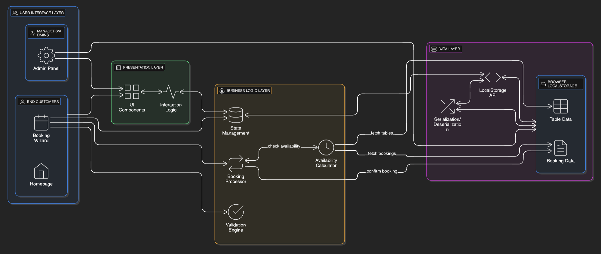
System Architecture

Slide 9
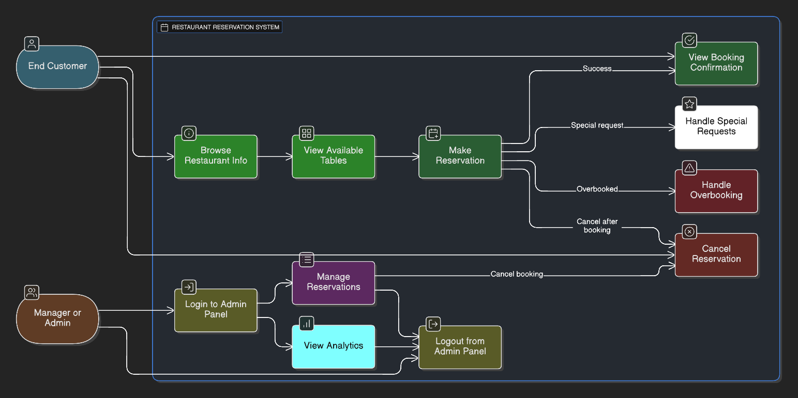
Use Case Diagram

Slide 10

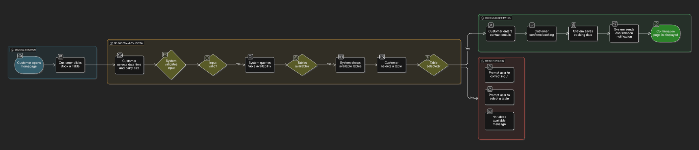
Booking Workflow

Slide 11
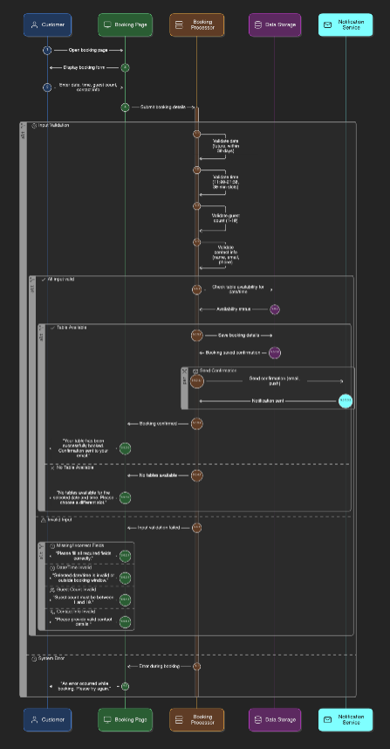
Sequence Diagram

Slide 12
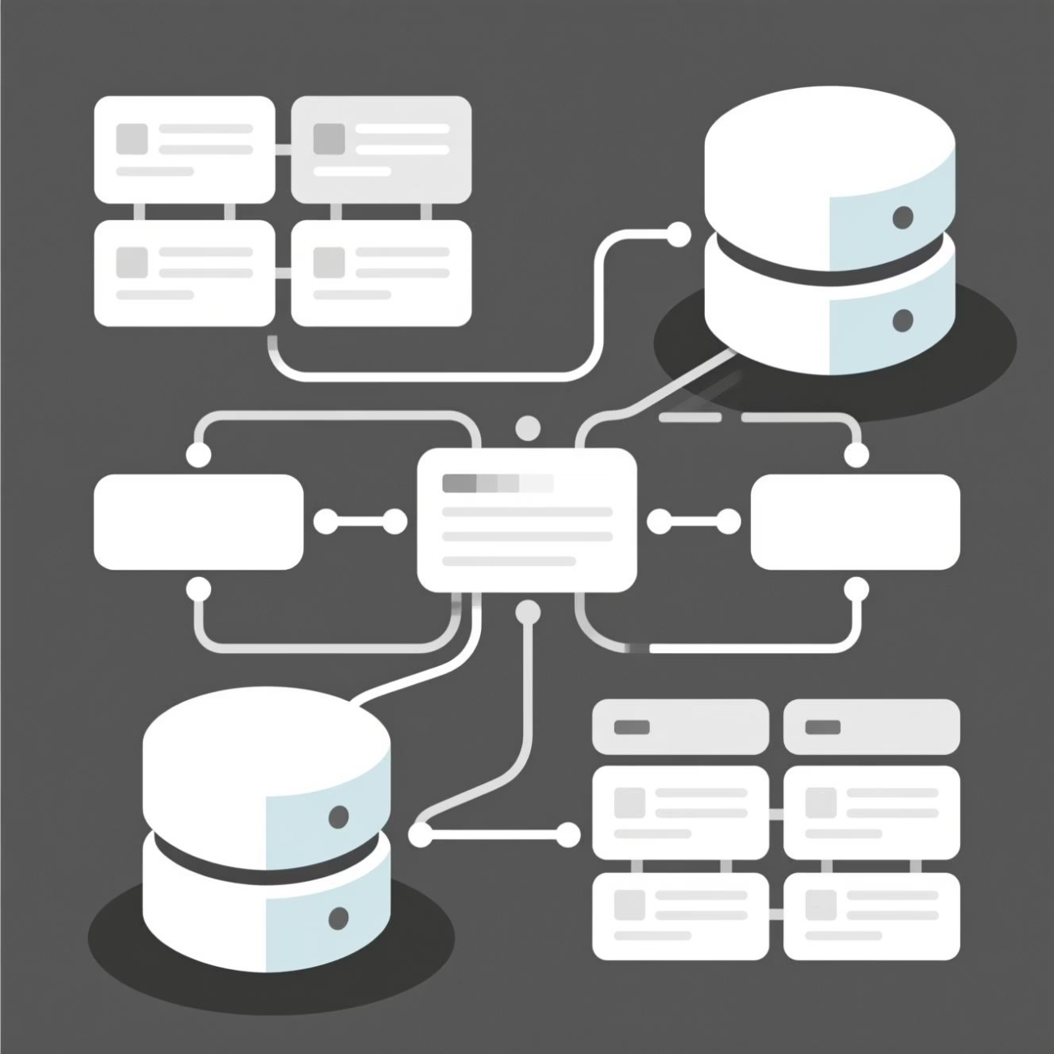
Database Design
Data Structure
The system uses three core schemas stored as JSON in browser localStorage:
Bookings: id, name, date, time, guests, table number
Tables: number, capacity, booked status
Statistics: total bookings, daily bookings, guests, tables
This lightweight structure ensures fast data access while maintaining clear relationships between reservations, table availability, and system analytics.

Slide 13
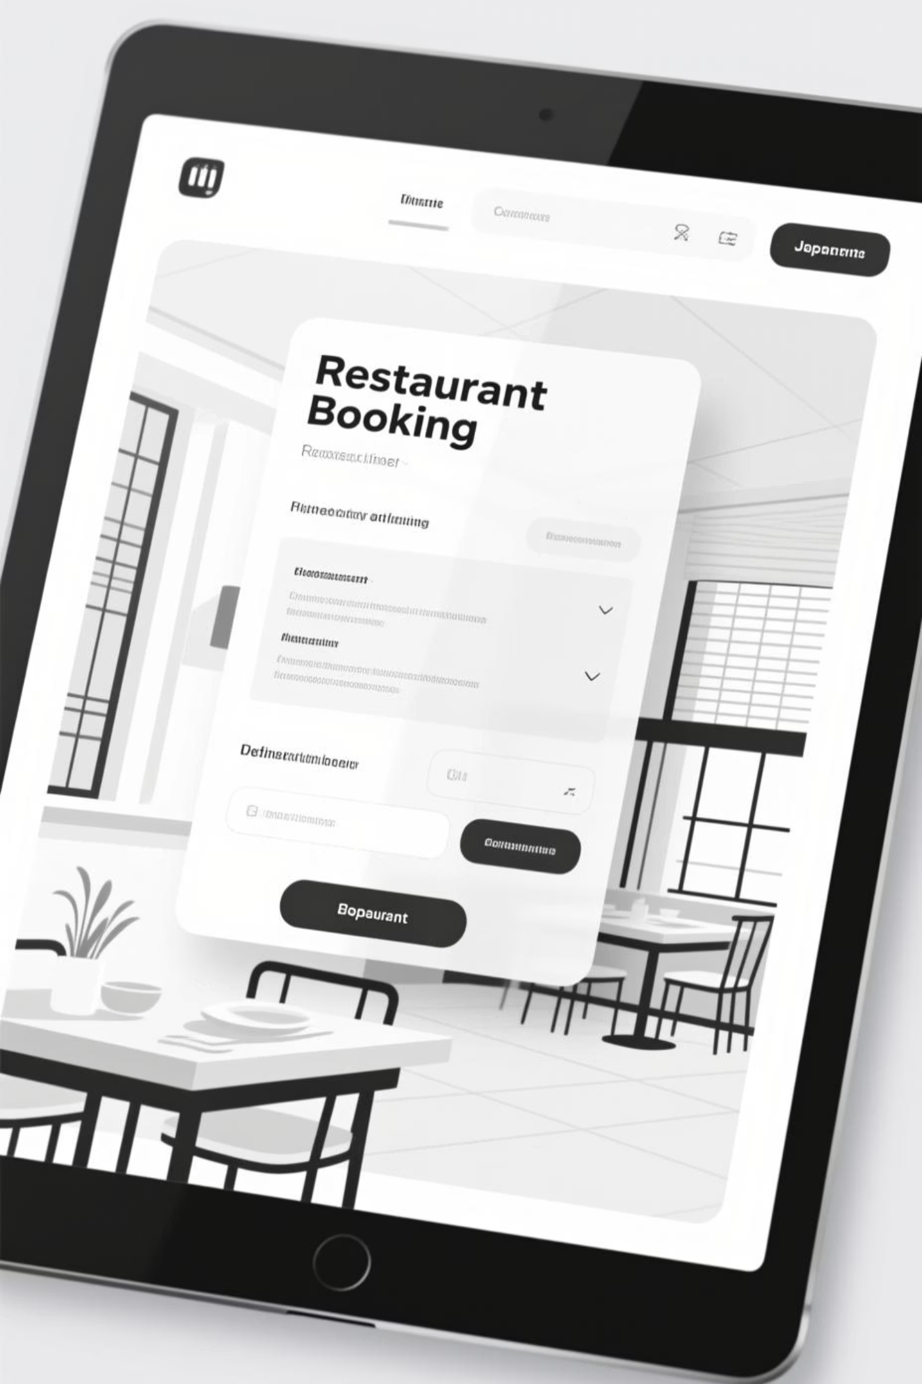
User Interface & Experience
01
02
Homepage
Booking Wizard
Restaurant information and real-time statistics dashboard
Multi-step process: select date, time, guests, then choose table and enter contact details
03
Admin Dashboard
Secure login with bookings table, analytics cards, and cancel/restore functions
Every interface follows responsive and accessible design principles, ensuring seamless experiences across devices and user abilities.

Slide 14
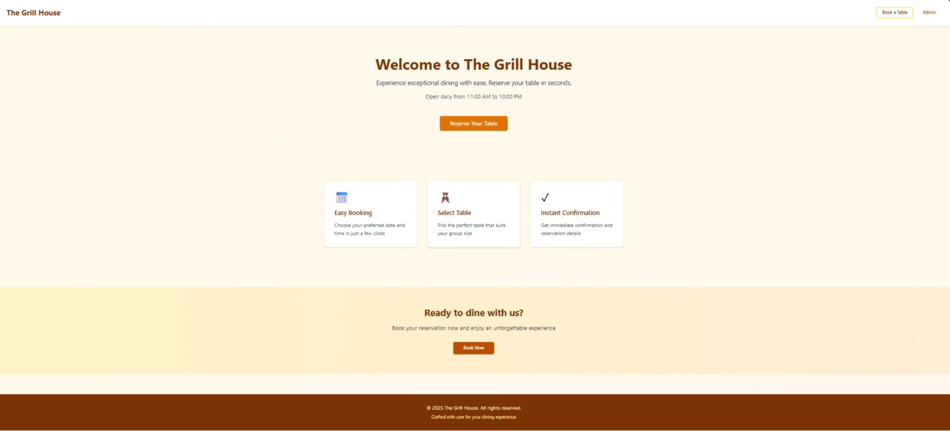
Home Page

Slide 15
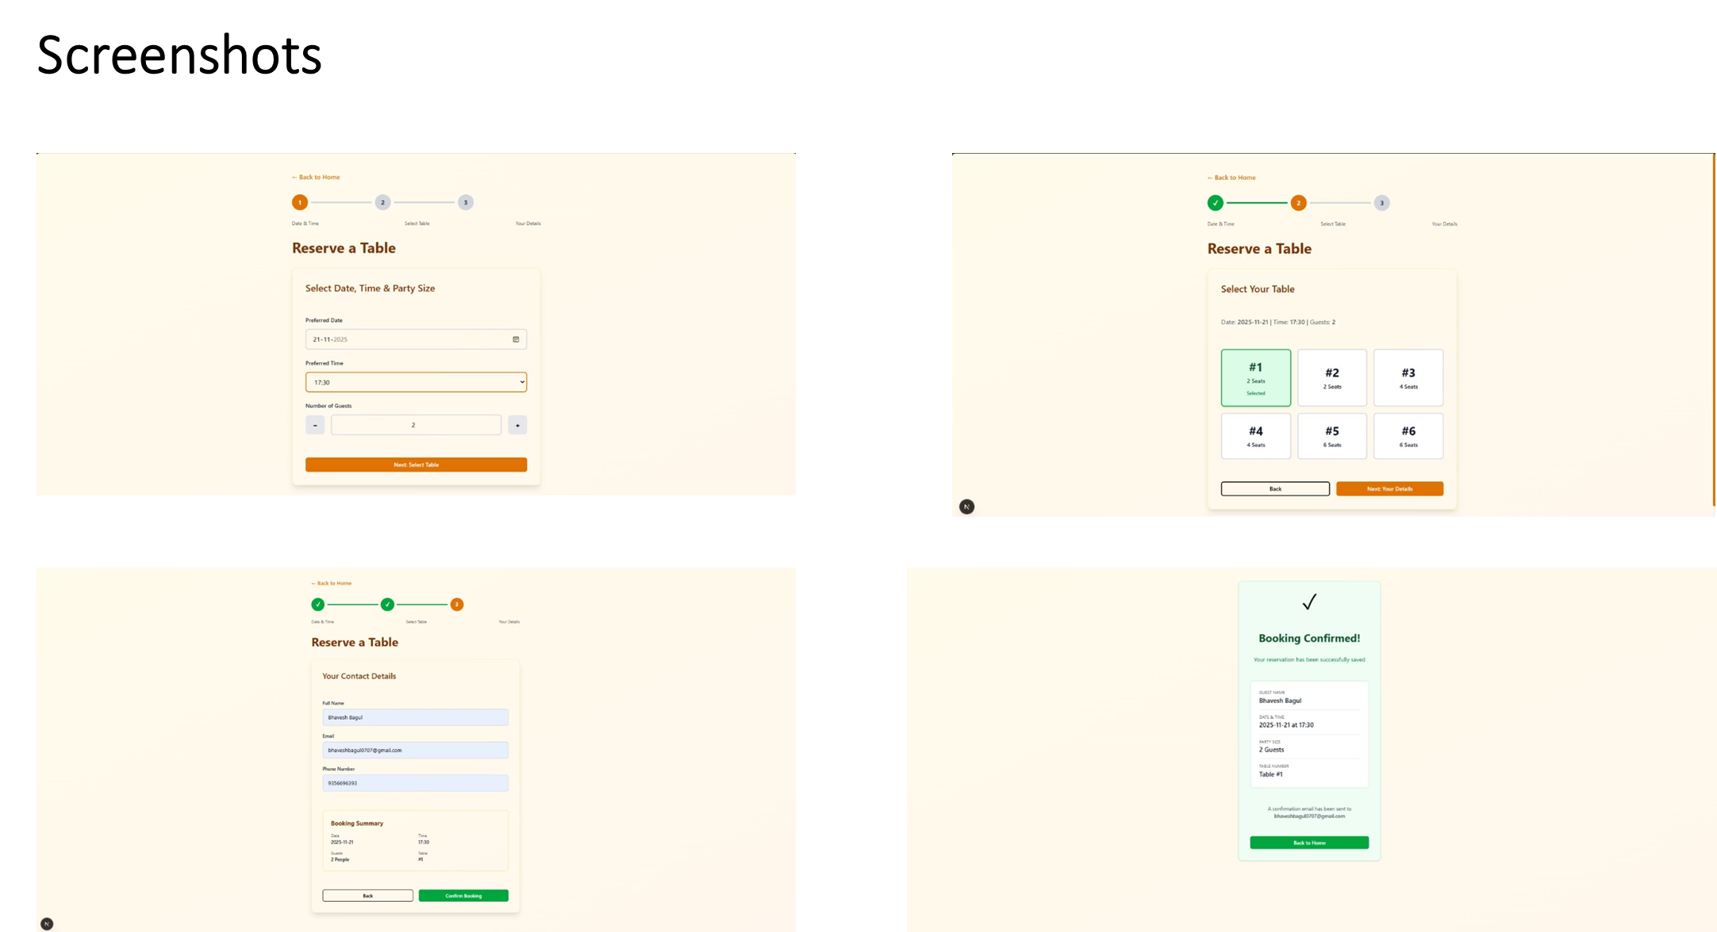

Slide 16
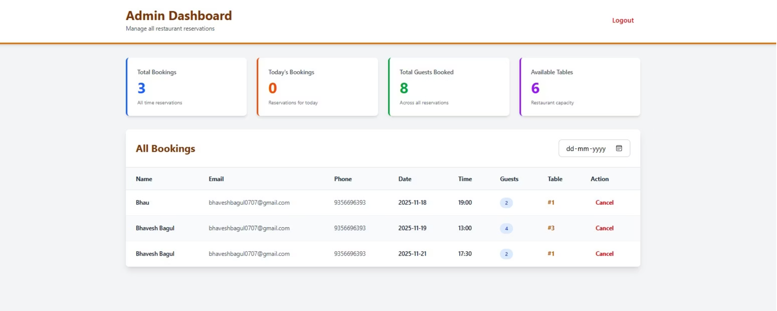
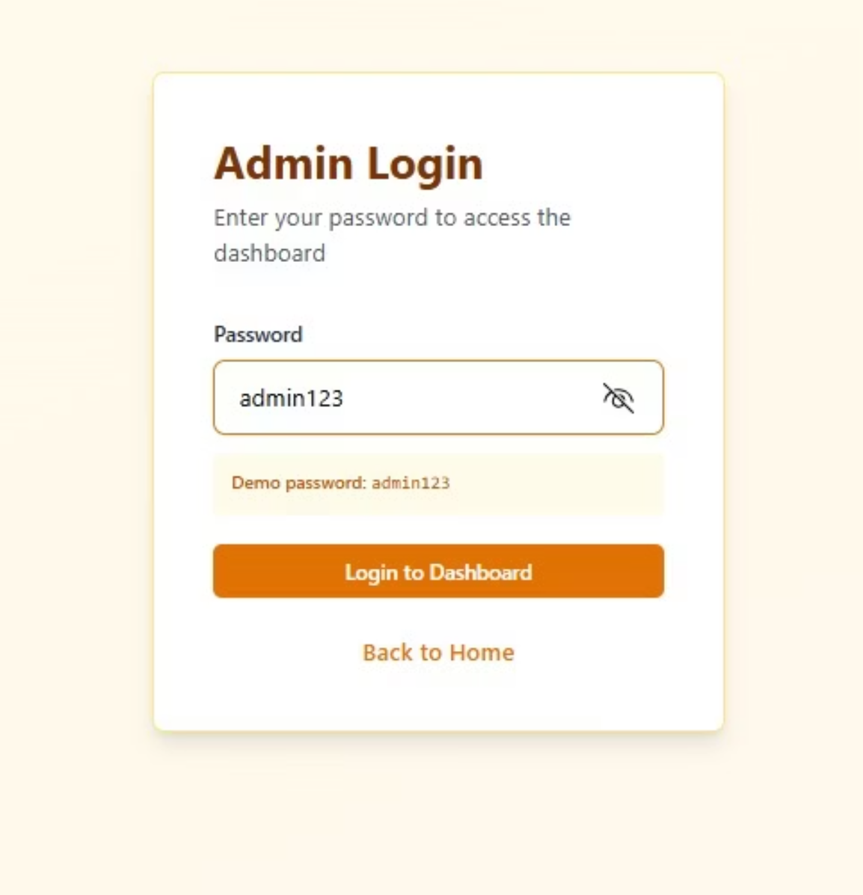
Admin

Slide 17
Business Logic
Validation
Availability Check
Verify booking requests with correct date formats, valid time slots, and appropriate guest numbers
Prevent double booking by checking table availability for specific date and time combinations
Data Management
Real-Time Updates
Filter and sort bookings efficiently for admin dashboard views
Instantly refresh UI components and statistics after every booking action

Slide 18

Security Measures
Current Implementation
Known Limitations
Admin access is password-protected to prevent unauthorized modifications. As a client-side demonstration, the system operates entirely in the browser using localStorage.
Browser-based storage has inherent security constraints. Data remains accessible through developer tools, and there's no server-side validation.
Future Recommendations
Implement encrypted storage, robust authentication protocols, and role-based access control for production environments.

Slide 19
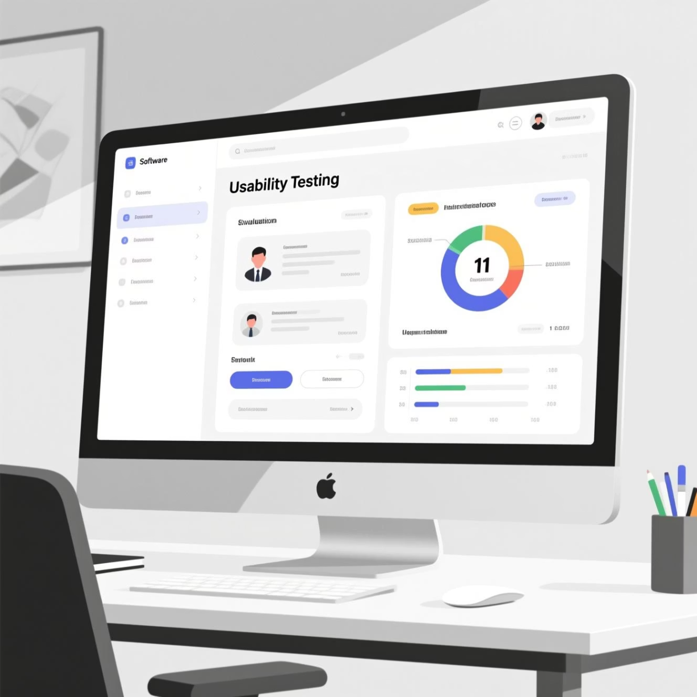
Usability Testing & Optimization
Testing Approach
We conducted comprehensive testing across all user flows:
Complete booking process from start to confirmation
Admin cancellation and restoration workflows
Validation error handling for empty fields and incorrect data
Performance optimization for fast data access and UI responsiveness
User Feedback
"Easy, intuitive, and fast—exactly what we need for managing reservations."

Slide 20




Scalability & Performance
Current Capacity
Handles thousands of bookings efficiently within localStorage constraints
Optimization Ideas
Implement pagination and integrate backend/cloud database for future expansion
Modular Architecture
Designed for easy extension: multi-restaurant support, advanced analytics, and enhanced features

Slide 21






Future Scope
Backend Integration
Communication
Develop REST API and database for persistent data storage across sessions and devices
Add email and SMS notifications for booking confirmations and reminders
Customer Portal
Authentication
Enable customer login with booking history and profile management
Implement secure authentication systems for both admins and customers
Multi-Location
Payments
Expand to support multiple restaurants and locations under one platform
Integrate payment processing for deposits or prepaid reservations

Slide 22


Conclusion
This reservation system delivers a robust foundation for modernizing restaurant operations. Its modular architecture, intuitive interface, and efficient workflows successfully meet all project objectives while offering significant improvements over traditional manual systems.
The design is deliberately future-ready, built to seamlessly integrate with backend services and advanced features as needs evolve. From validation logic to user experience, every component has been crafted to balance immediate functionality with long-term scalability.
This system demonstrates how thoughtful design and clean architecture can transform routine operations into streamlined, user-friendly experiences that benefit both staff and customers.

